Slide 1
Main Figures

Slide 2
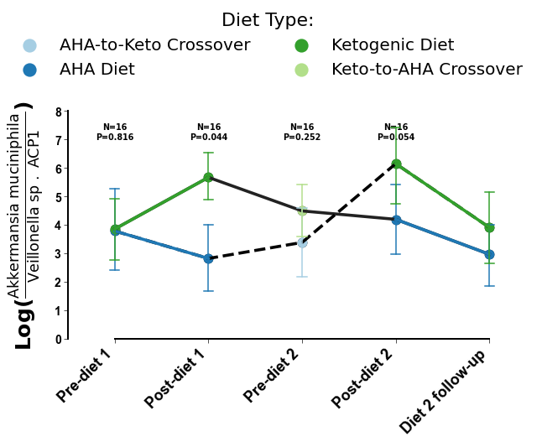
A
B
Notes:
Figure 1. Cross-sectional beta-diversity analysis demonstrates subject specific microbiome and metabolome. Repeated measures aware beta-diversity observe diet specific cross-over trends.

Slide 3
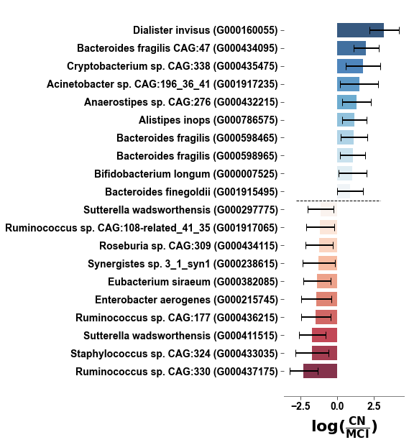
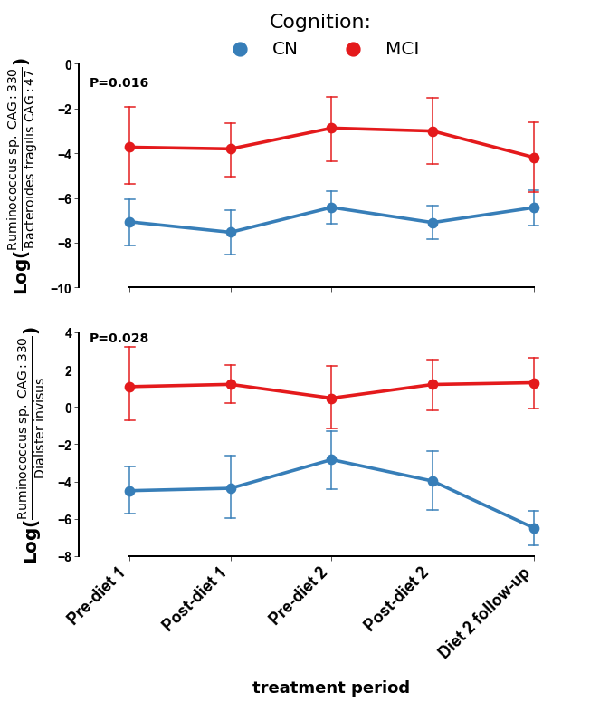
Microbiome
Food Omics
Metabolomics
A
B
C
D
E
Notes:
Figure 2. Differential abundance model controlling for repeated measures and subject specificity identify cognition specific markers that are not impacted by diet.

Slide 4
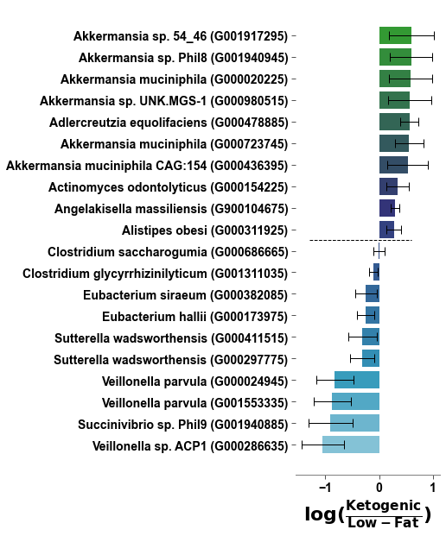
Microbiome
Food Omics
Metabolomics
A
B
C
D
E
F
Notes:
Figure 3. Differential abundance model controlling for repeated measures and subject specificity identify diet specific markers that follow cross-over design.

Slide 5
Microbiome
Metabolomics
A
C
B
D
Notes:
Figure 4. Differentially abundant microbes, food groups, and metabolites associated with both low-fat diet and mild cognitive impairment or ketogenic diet and normal cognition also co-occur together differentially by associated groups.

Slide 6
A
B
C
Notes:
Figure 5.

Slide 7
Supplemental Figures

Slide 8
A
Microbiome
C
Food Omics
E
Metabolomics
B
D
F
Notes:
Figure 4. Differentially abundant microbes, food groups, and metabolites associated with both low-fat diet and mild cognitive impairment or ketogenic diet and normal cognition also co-occur together differentially by associated groups.

Slide 9
Notes:
Figure S1. TODO

